Slide 1


AI(Artificial Intelligence)
Impact of AI(Artificial Intelligence) on India and the world.

Slide 2
SWOT ANALYSIS OF AI
S
STRENGTHS
W
WEAKNESSES
On Efficiency, Data Processing power, 24/7, Predictive Analysis.
High development cost, Secuirty & Privecy risks, Job displacement, Emotional intelligence.
O
OPPORTUNITIES
T
THREATS
Helthcare advancements, Smartcities,Education,Bussiness, Scientific reserch.
Security threats, Regulatory & Legal challenge, Public distruct.

Slide 3
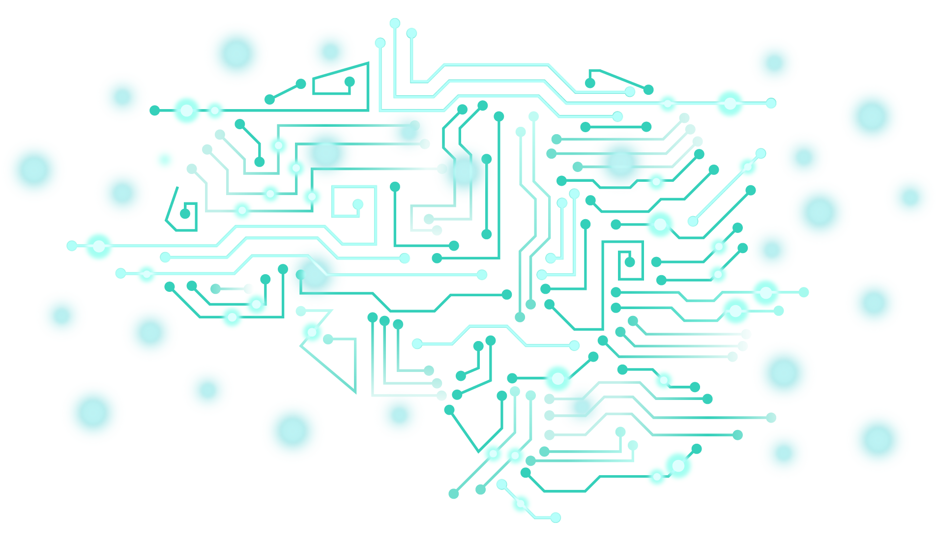
IMPACT OF AI IN INDIA
HOW IT WORKS
ECONOMIC GROWTH
GOVERNMENT
INITIATIVES
HEALTHCARE
EDUCATION
AGRICULTURE
FINANCIAL

Slide 4
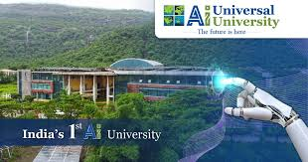
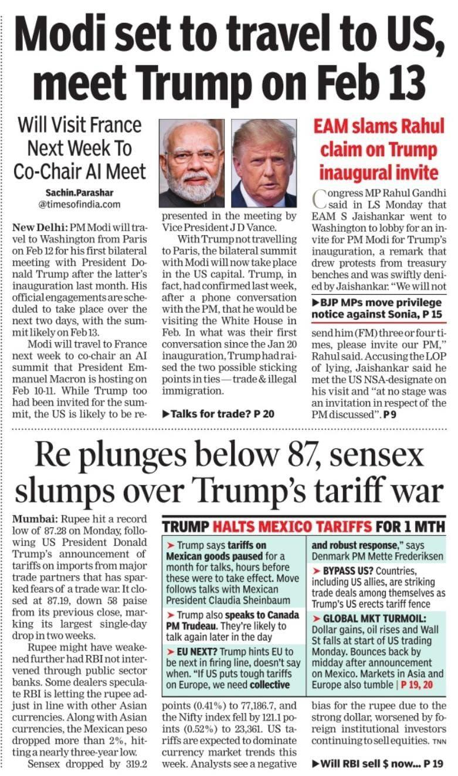
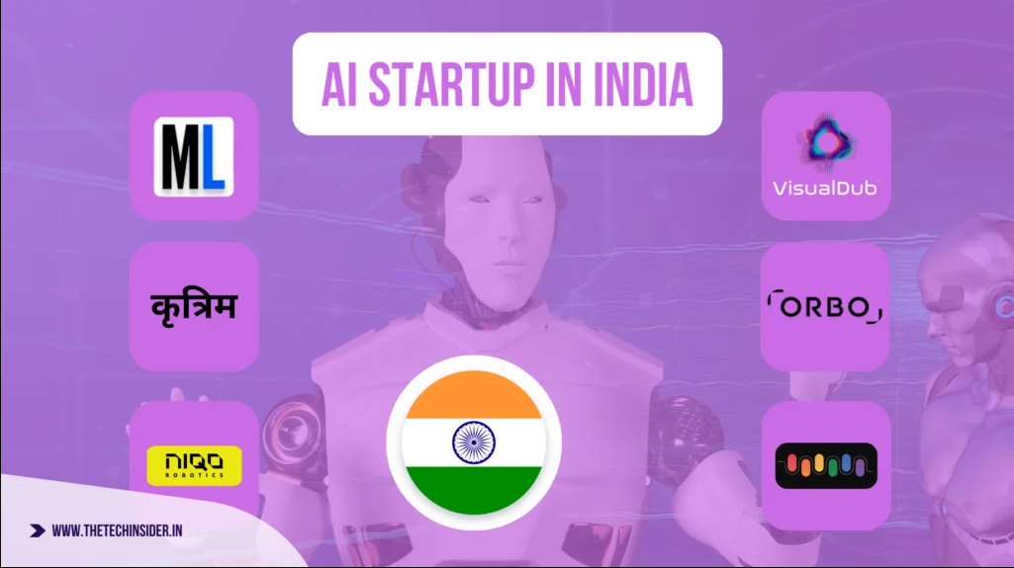
Indian first university India’s first artificial intelligence university will be built in Maharashtra and has announced to create such a “center of Excellence”. In this university, works will be done in skill development, innovation and policy making of the country.
INDIA’S WORKS IN THE FIELD OF AI
AI Summit 10-11
Public service AI, Future of works, Innovation and culture, Trust in AI, Global governance of Ai.
This summit conference will be held in Paris, the capital of France. In which the prime minister of our country will be present as the speaker. This conference will be hosted by French President Emmanuel Macro.
Startup
India’s AI startup ecosystem is growing rapidly. If you have a strong AI-based solution, a skilled team, and a scalable business model, you can build a successful AI startup in India. Would you like with a business plan or funding opportunities.

Slide 5
Thank You
Question Answer Session

